Slide 1


Slide 2


about:me
Gabriel Ivănică
Reprezentant Mozilla
JavaScript++
gabriel.ivanica@mozilla.ro

Slide 3
History
1998 – 2000 Project Code Rush (Netscape)
1999 – AOL buys Netscape
The Mozilla project

Slide 4
A global community with a shared mission

Slide 5
Build the internet the world needs
For people, not for profit

Slide 6


Slide 7

Firefox 1.0 - 2004

Slide 8
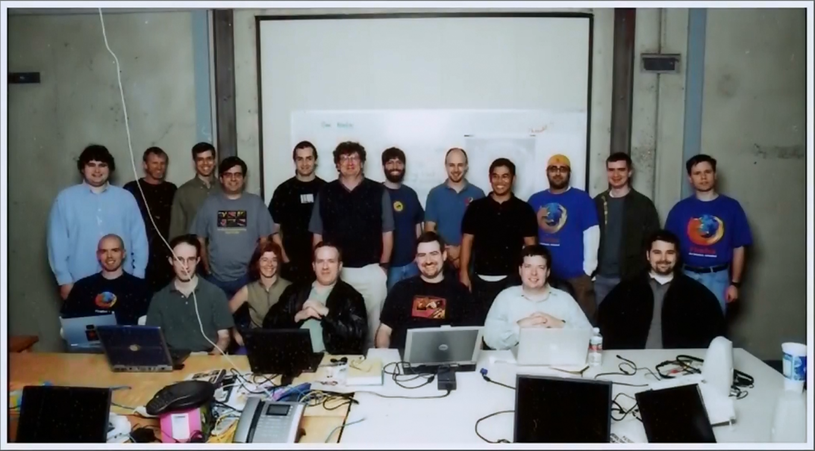

Slide 9
Mozilla Foundation
non-profit organization that promotes openness, innovation and participation on the Internet. We promote the values of an open Internet to the broader world.

Slide 10
4 pillars of activity
Build
Empower communities
Teach
Shape

Slide 11
Products
Respect people (security and privacy)

Slide 12
Empowering communities

Slide 13
Teach and learn

Slide 14
Imagine, Build, Teach
Shape

